Slide 1
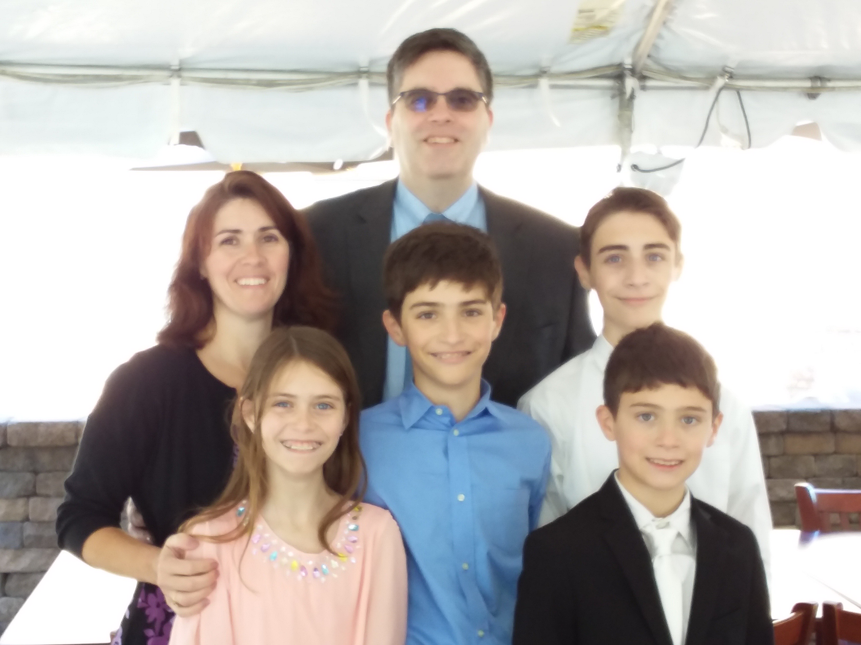

To my 5th grade teacher
By: Adam Bruzas
Notes:
Title slide- First and last name Nickname, audio recording of how you say your name, fun, colorful design

Slide 2
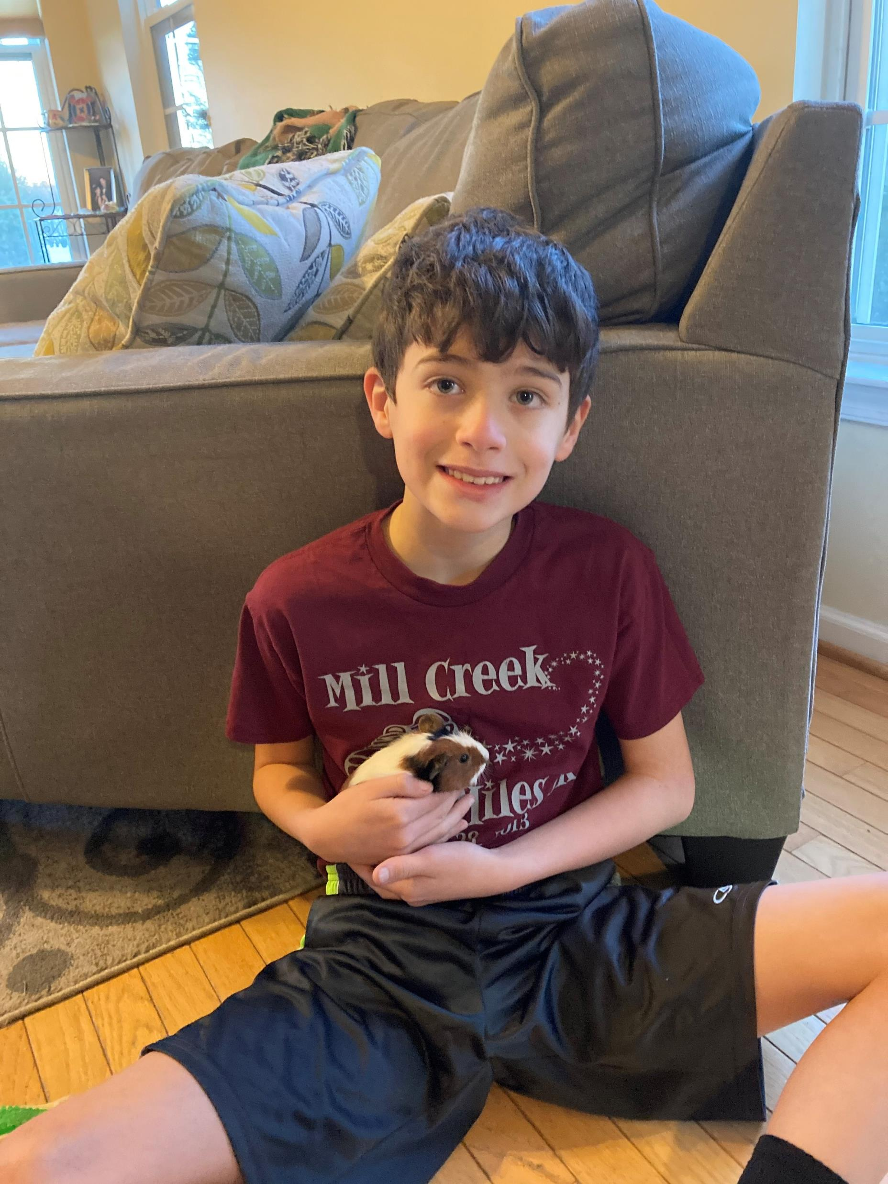
Mr. T’s motivating audio message
Notes:
Decorate

Slide 3

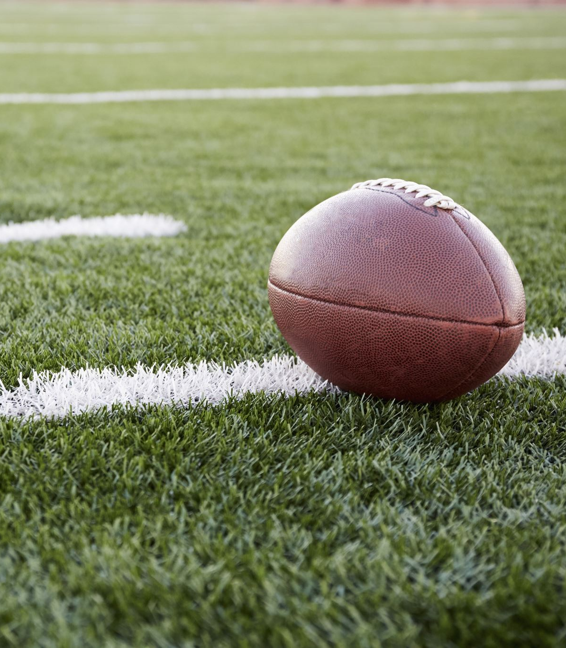



My hobbies
Football
Math
Basketball
Creative
Notes:
5 pictures or gifs of hobbies (things I like to do)

Slide 4
My family
My Mom
My dad
Sister Victoria
Brothers Luke and Michael
Connie may cat
Mack my cat
Fen my dog
Ginger my ginna pig
Carmel my sister’s ginna pigs
Notes:
Family members- their names, their likes, or jobs, or fun facts

Slide 5
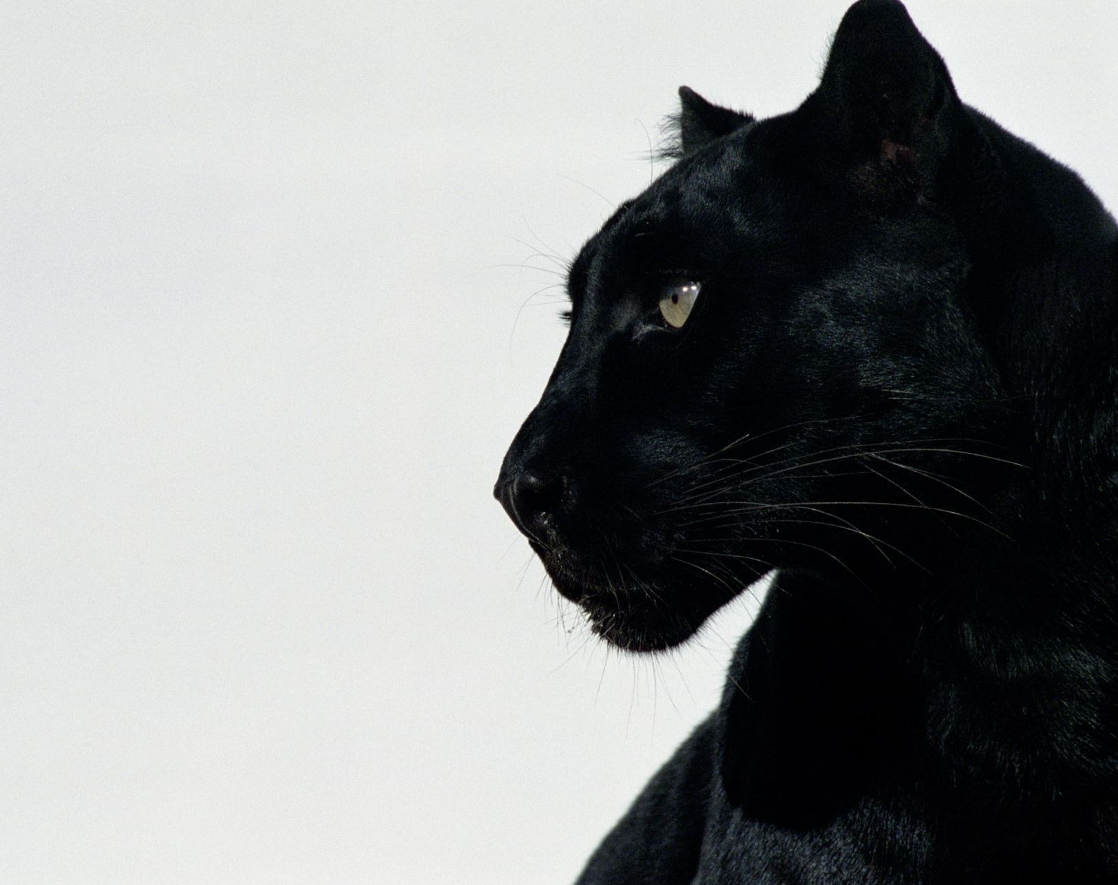
My likes
Math Virginia
Animals New York
Tech Disney World
Creative
Food
My family
Michael
Luke
Victoria
Notes:
3 Places, 3 people you enjoy

Slide 6

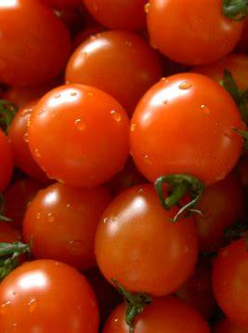


My dislikes
Homework
Baseball
Soccer
Tomatoes
Notes:
4 Pictures of things you don’t like or don’t like yet

Slide 7
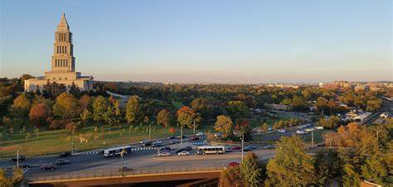
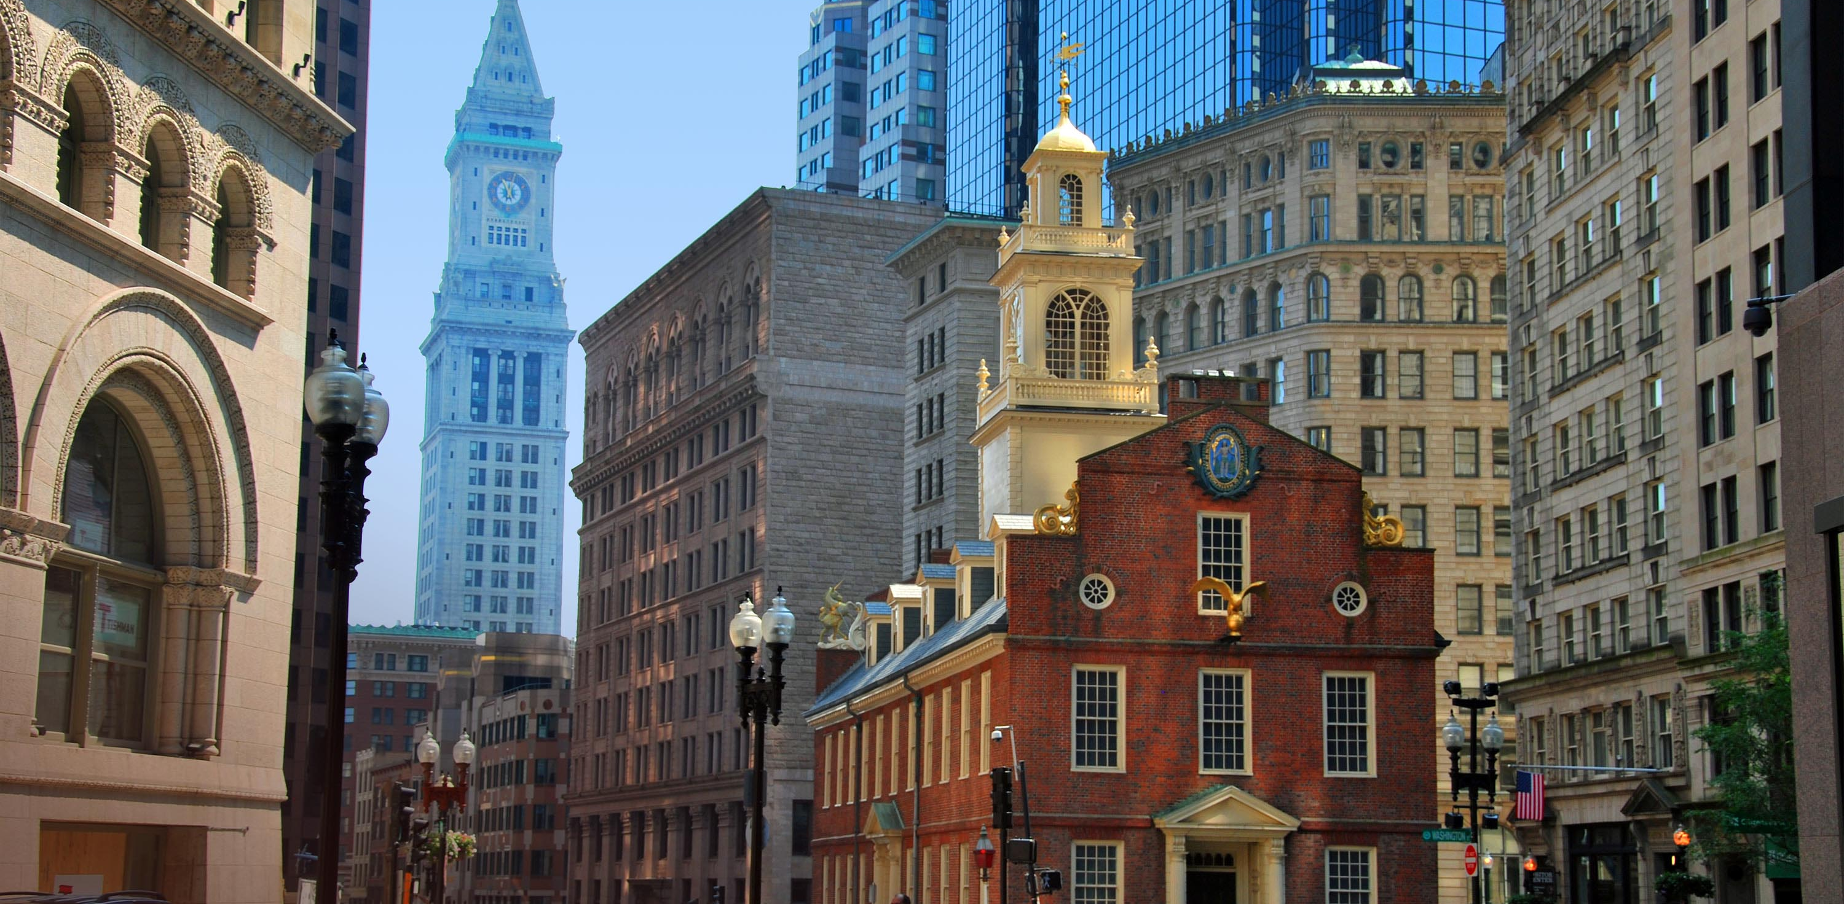
My history
Disney world
New York
Virginia
Boston Massachusetts
Notes:
4 things about your past: teachers you had, Halloween costumes, place you’ve been, lessons you learned, accomplishments

Slide 8
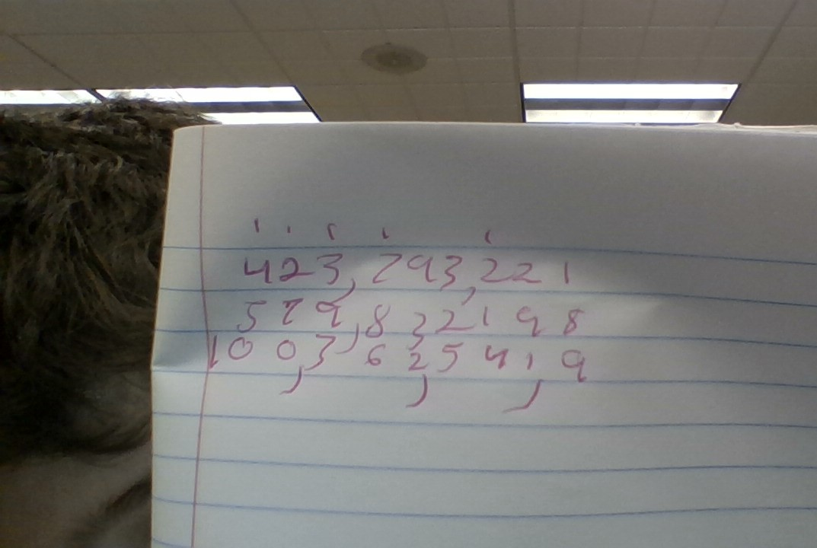
My Math Skills
Super good
Notes:
Snip of great work on your SeeSaw math, Snip of IXL accomplishments, an example of your great math work, and one math goal for 5th grade

Slide 9
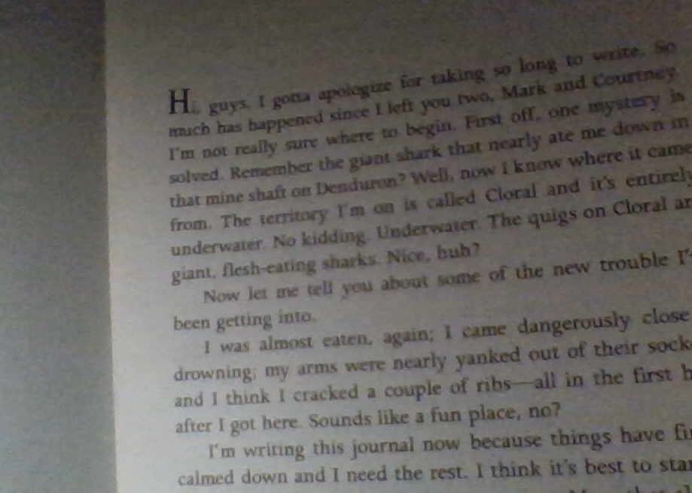
Reading Skills the lost city of farr
Notes:
Pictures of Squirt books you’ve read, Sound recording of you reading a page of your book, 1 reading goal that you’d like to achieve in 5th grade

Slide 10
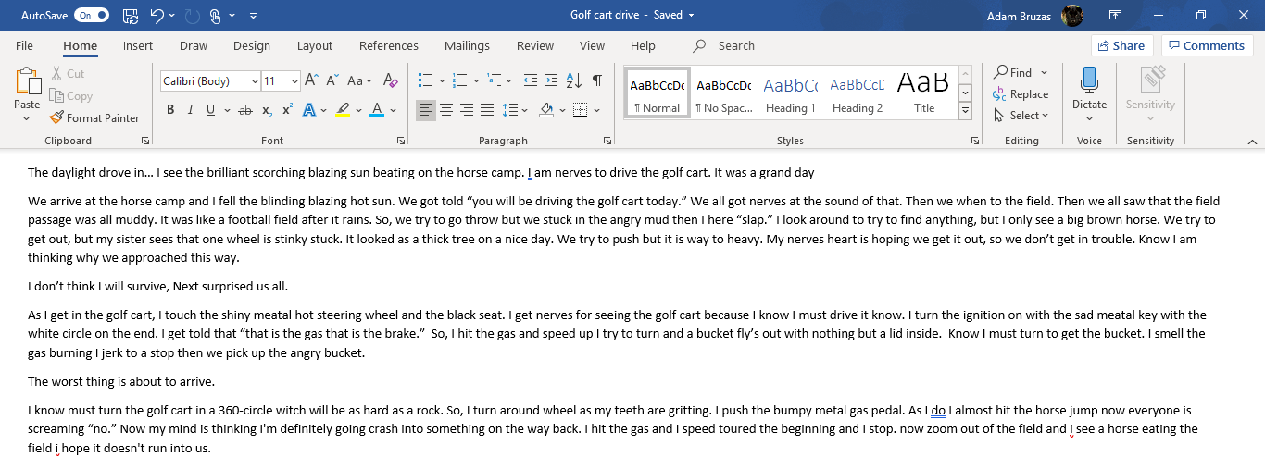
Writing Skills
Notes:
Snip of Mother’s Day Writing or a story from your One Drive, or your Journal. List 2 writing strengths, and 2 writing goals you’d like to accomplish in 5th grade

Slide 11

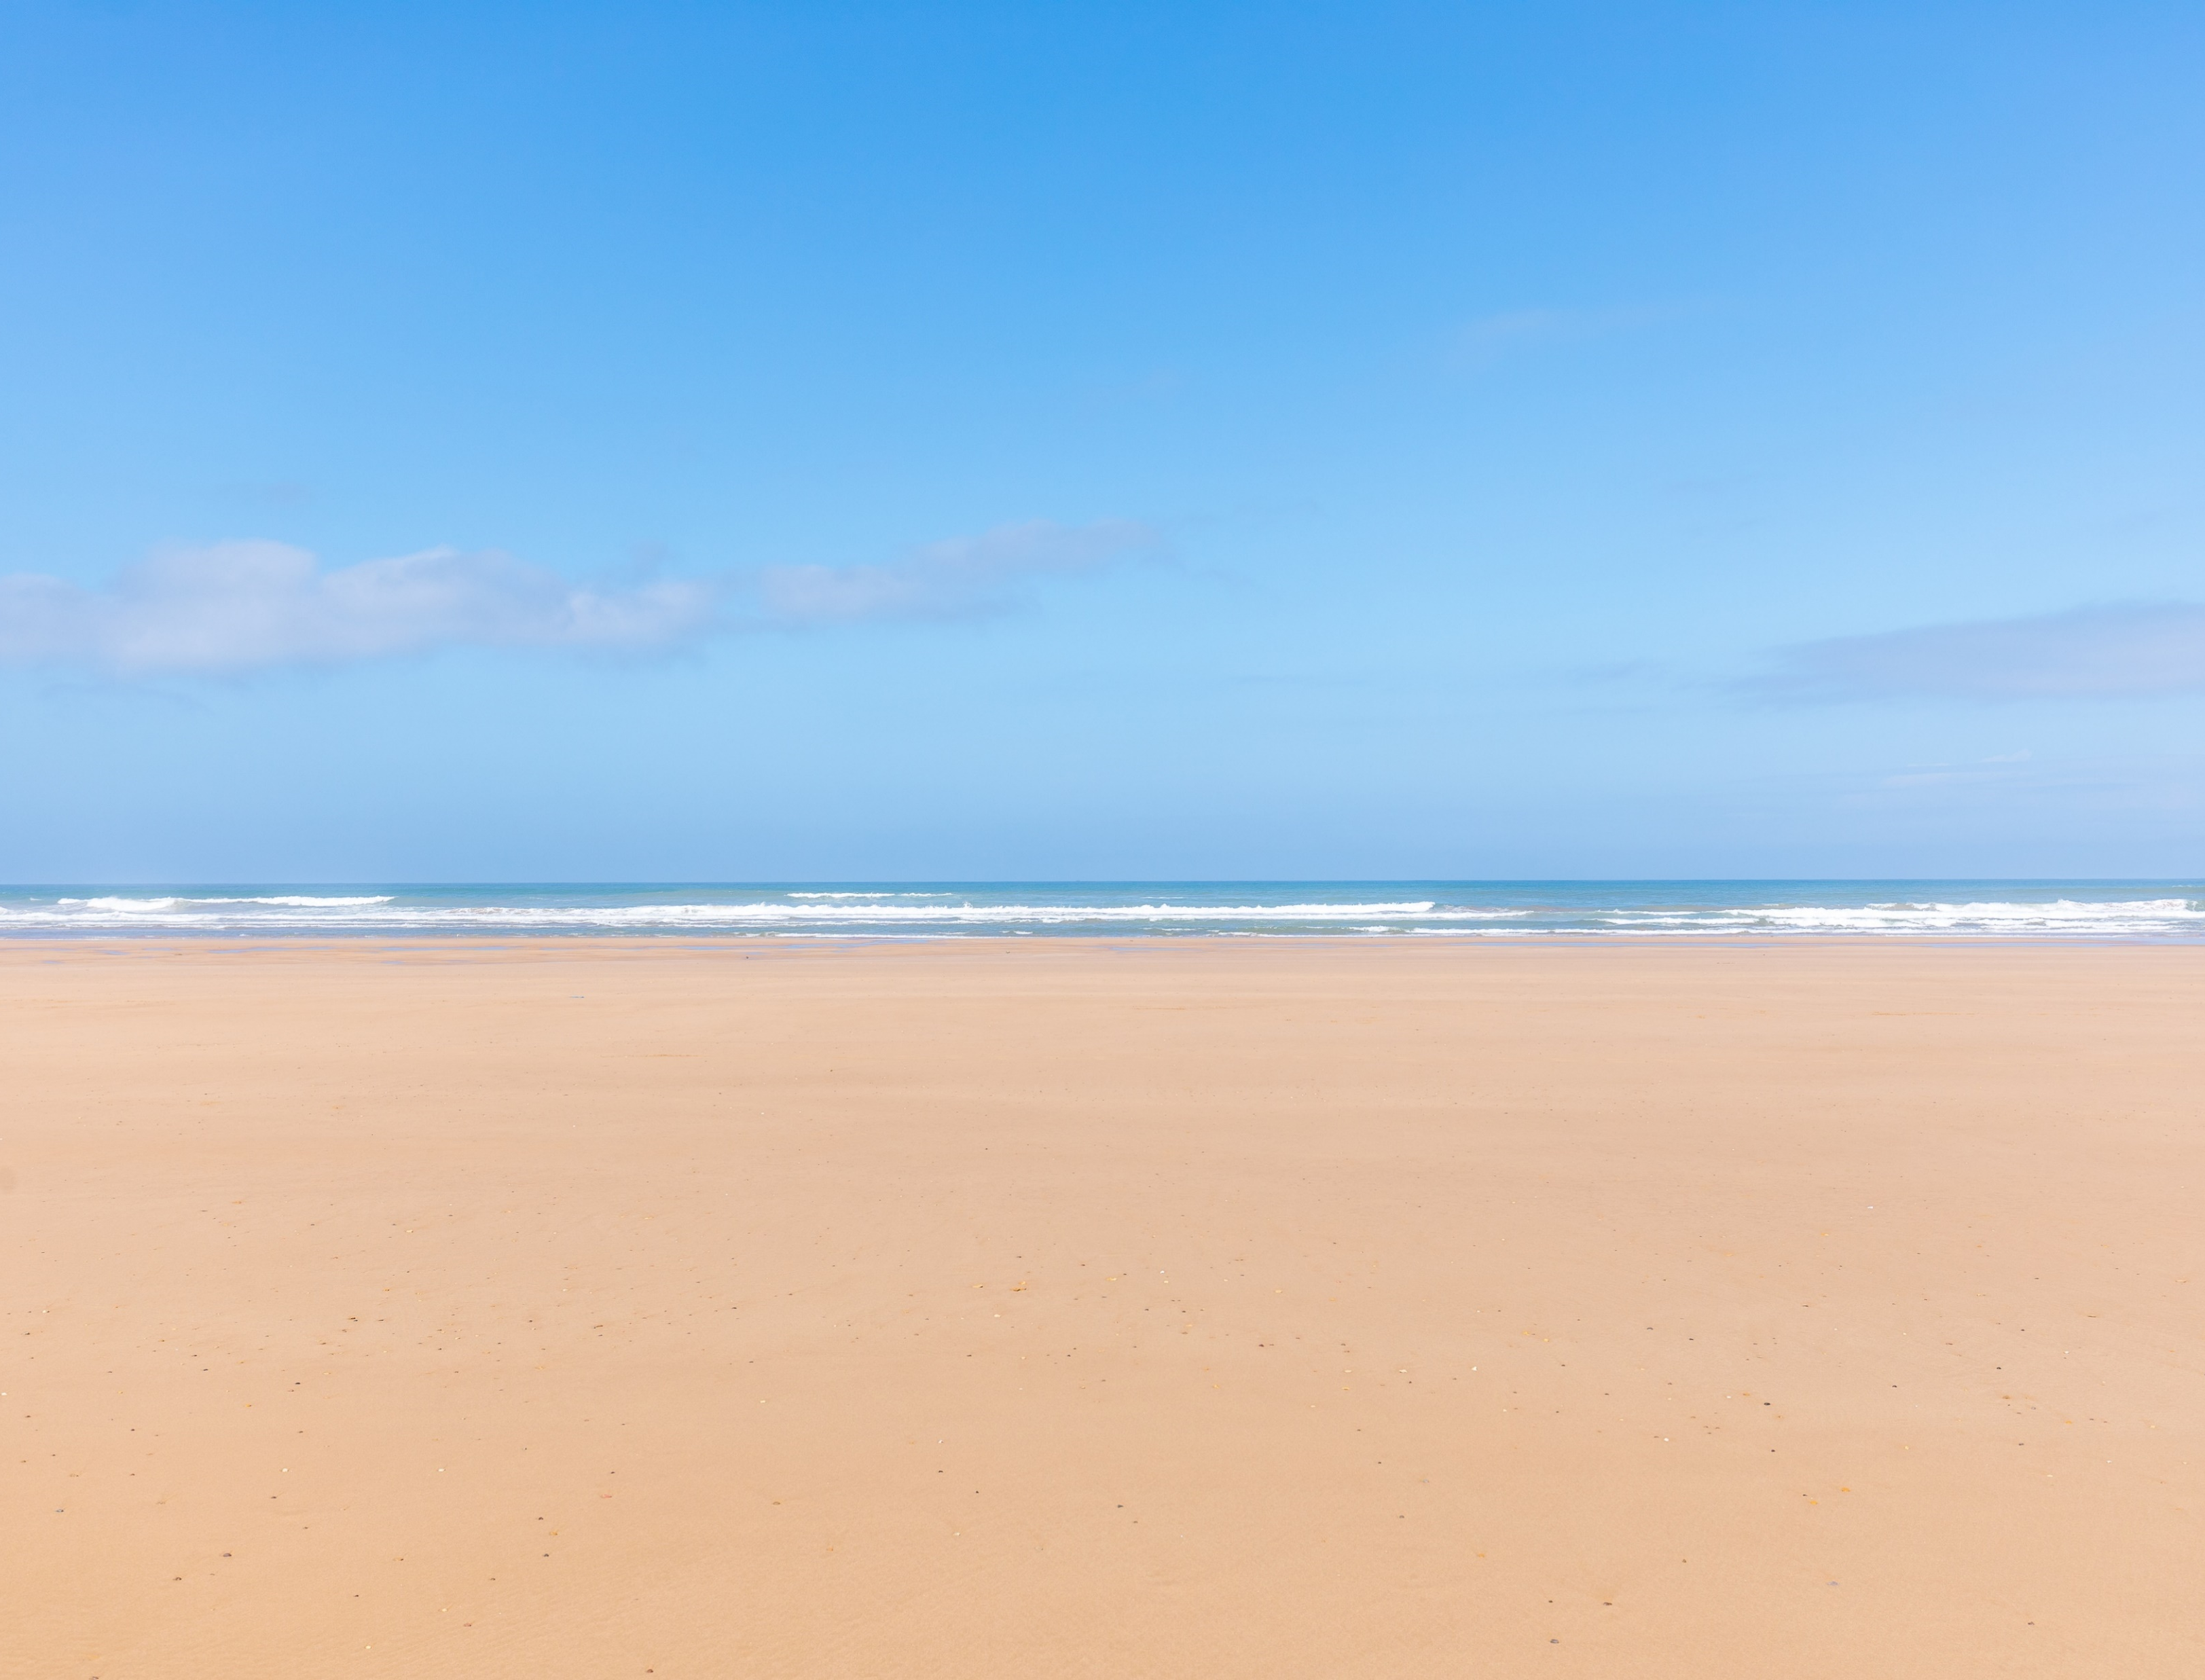
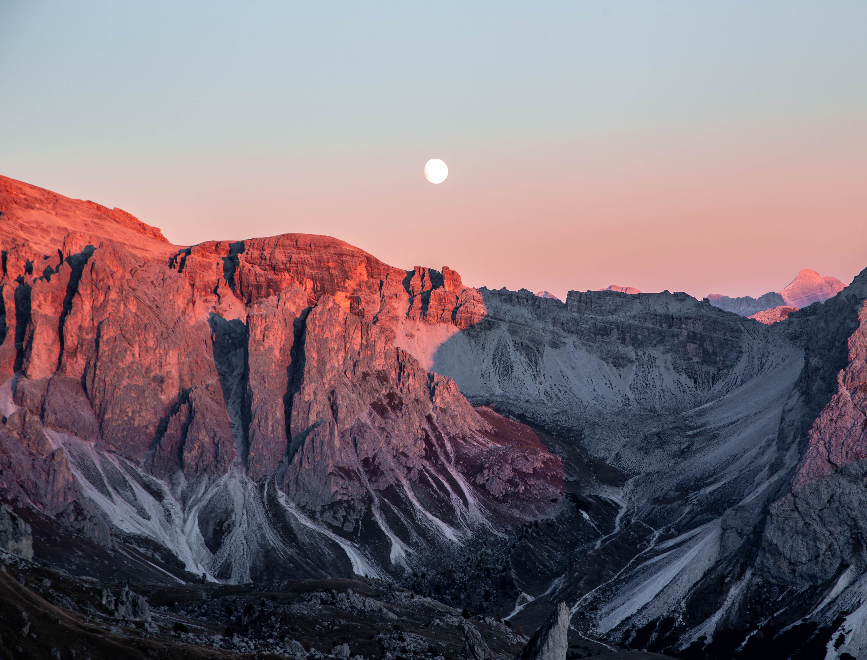
Summer Plans
Vacation
Go to Mom-moms house
Have fun
See friends
Go outside
Beach
Rock climbing
Notes:
4 pictures of what you would like to do this summer and a voice recording of each activity

Slide 12
Questions for my 5th grade teacher
Are you nice
What is your favorite color
Where are you from
Notes:
3 questions for your 5th grade teacher. Include a video of yourself speaking.

